Slide 1

Communication Differences
Notes:
Communication differences – Frustration – Overwhelmed – In pain – Uncomfortable – Can’t understand – Can’t keep up – Unable to concentrate
ALL lead to increased stress and anxiety.
Number 1 need to meet = LOWERING STRESS AND ANXIETY

Slide 2
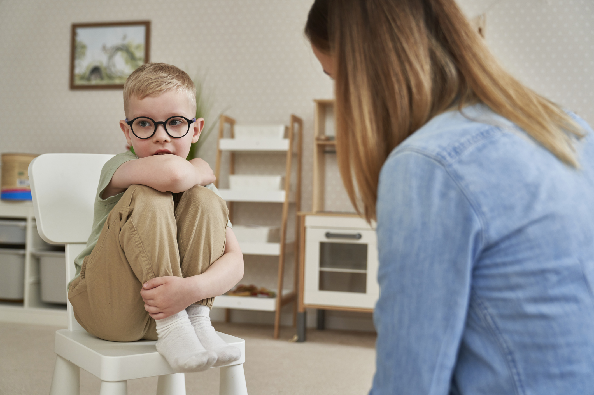

Giving YOU a hard time, or, having a hard time?
Notes:
We should ask ourselves this….
Blow up empathy balloon

Slide 3
Communication Difficulties
Limited comprehension
Extended processing
Limited Expressive Language
Struggling with Articulation
Notes:
Comprehension – understanding of a word or message
More delay or taking longer to remember or store what has been said
How somebody expresses themselves or formulates a word or sentence
Speech sounds, so may sound unintelligible, slurred or disordered

Slide 4
Communicative abilities
These are often either over estimated
or
They can be under estimated
Notes:
Overestimated – somebody speaks clearly but their processing is slower and so cannot receive information as fast as you
Underestimated – may be slow of speech, resulting in you thinking that they don’t really understand or can’t hear you which may not be the case....

Slide 5
Tips for communication
Well-lit environment
Reduce background noise
Ensure hearing aids and glasses are
in good order
Notes:
Well lit environment – more likely to have hearing and visual impairments – may lip read and need to see your face
Reduce background noise – sitting close enough for them to read your facial cues
Hearing aids and glasses are clean, on and regularly reviewed

Slide 6
Tips for communication
Allowing time for children to process
Notes:
Allowing plenty of time for children to respond.
Don’t talk too fast – slower processing makes it harder to follow
Keep language simple and short

Slide 7

Time to Process
Experiential Exercise
Notes:
Choose a delegate
Explain that you are going to ask them a simple question – they will know the answer!
Ask them to respond
Ask ‘what colour top are you wearing?
Now tell them you will ask the same question
Ask them to count to 10 very slowly in their head before answering
If trainer interrupts their count, they have to go back to 1 and continue to count

Slide 8
Tips for communication
Allowing time for children to process
Don’t talk too fast
Keep language simple and short
Notes:
Allowing plenty of time for children to respond.
Don’t talk too fast – slower processing makes it harder to follow
Keep language simple and short

Slide 9
Tips for communication
Use everyday words
Avoid double meaning words
Use literal language
Notes:
Use everyday words – not long confusing words
Think about context of words – that can’t be misconstrued
Use literal language – avoid ‘you’ve been through the war’

Slide 10
Tips for communication
Adopt a
Total Communication Approach
Notes:
Use a total communication approach – white boards, signing, physical objects, pictures

Slide 11


Slide 12
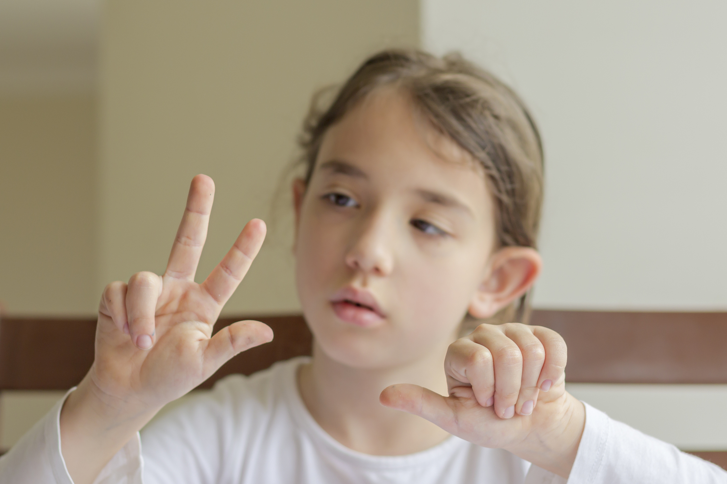
Notes:
Any signing – Makaton, BSL

Slide 13


Slide 14




Slide 15
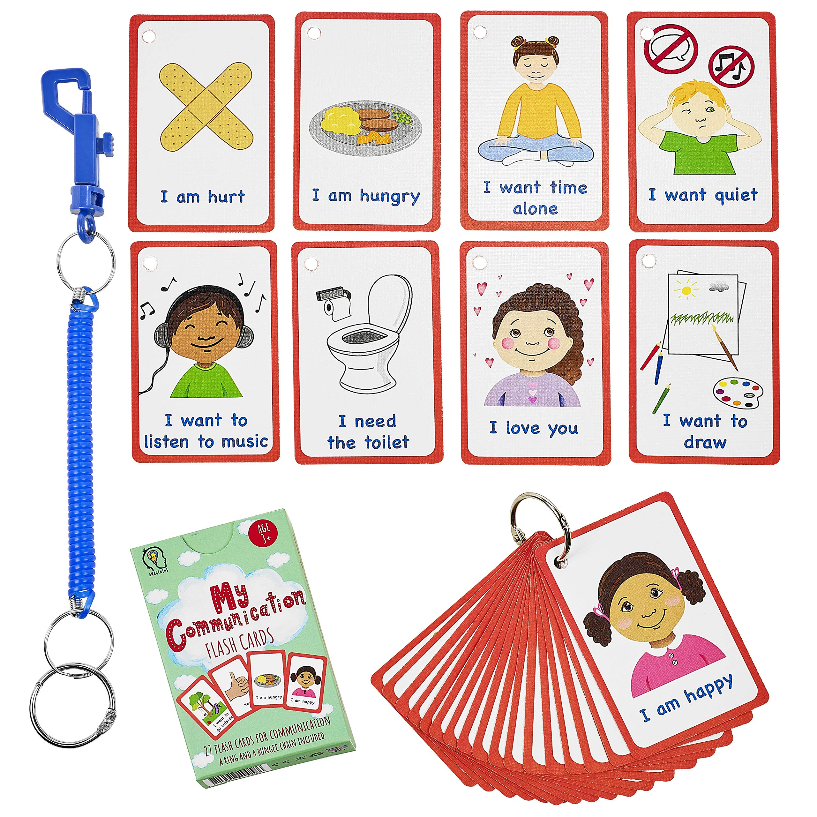
Notes:
Picture Exchange Communication System
To help them signal what they want
To help them structure sentences
To help them answer questions

Slide 16
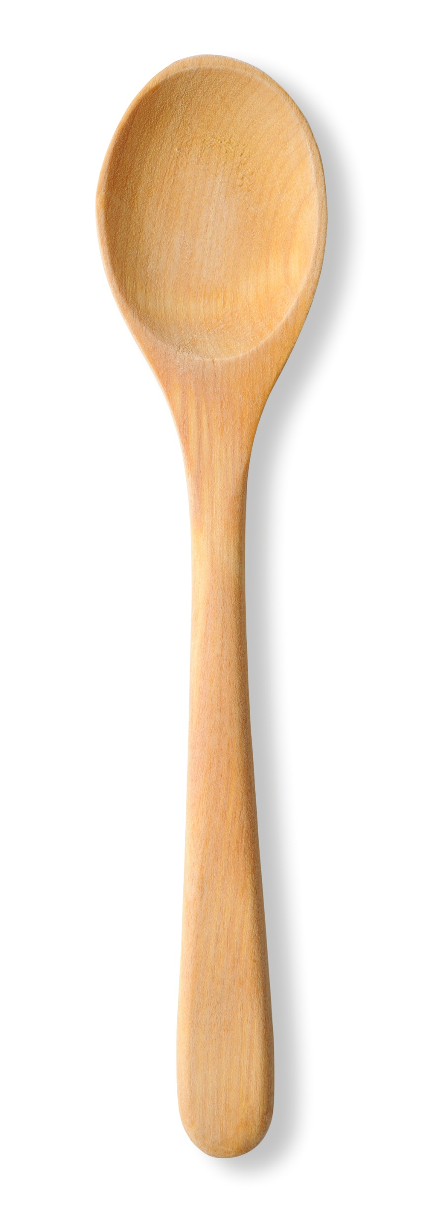


Notes:
Objects of Reference –
Physical objects that can be understood by the child
Functional objects - Cup for a drink
Representative objects – artificial leaf to represent ‘outdoors’ or miniature versions such as dolls house furniture or pictures
Things that the child associates with activity (wooden spoon for baking)

Slide 17

Notes:
Low tech options – paper and pen

Slide 18

https://www.gov.uk/government/publications/inclusive-communication/accessible-communication-formats
Notes:
Accessible Communication formats guidance

Slide 19

Any Questions?

