Slide 1


DAY 3

Slide 2

Password: ????????

Slide 3
Law and Legislation
Notes:
40 minutes
Reinforce importance of care staff knowing the law and how this should influence their actions
Understanding that the legislation exists to protect the right of the children as well as the rights of the care workers. If workers follow policy, procedure and their actions are supported by documents such as ISPs, Care Plans then they will be supported
There will be times when primary and secondary prevention has not been successful, it may then be necessary to support the young person with physical restrictive practice to keep them, workers and others safe.
It is essential that you are aware of the implication of legislation

Slide 4
Legal Defences
As a general rule, nobody has the right to
touch, move, hold or contain
another person.
Whenever they do so they should be clear about WHY it is
NECESSARY
Notes:
Introduce the concept of legal defences.
QUESTION: ask the group why they would need a legal defence?

Slide 5
Legal and Ethical Defences
The best legal defence would be to show that any actions taken were in the person’s
BEST INTEREST
and that they were
REASONABLE AND PROPORTIONATE
Notes:
Ensure the group understands REASONABLE & PROPORTIONATE
Also make the point that their LEGAL DEFENCE would be judged on being able to demonstrate that they used physical intervention due to the consequences they were trying to prevent! Having a mindset of PREVENTING CONSEQUENCES would ensure that they did not fall into the trap of FORCING COMPLAINCE and their intervention potentially being unlawful.

Slide 6
Purpose of Physical Intervention
The purpose of physical intervention is to take immediate control of a dangerous situation, in order to
end or significantly reduce
the risk of HARM
to the person and others around them.
Notes:
So their role is to keep people SAFE!
One of the things that we often see is people NOT Understanding the issue of using Physical intervention to FORCE COMPLIANCE which is likely to be illegal! You could be committing either assault or battery or both!

Slide 7
Defining Physical Intervention
The term physical intervention refers to
any method of responding to
unsafe behaviour which involves some degree of
direct physical contact
to limit movement
Notes:
QUESTION – Ask the group to give some examples of direct physical contact
Ensure that you make the point that it can be very low level i.e. TOUCH

Slide 8
Defining Physical Intervention
This can include touching,
guiding, escorting,
all the way up to holding.
Notes:
READ, Then…
As you can see from touching, guiding or escorting all the way up to holding, physical intervention can start at a low level and progressively increase all the way up to actually HOLDING

Slide 9

Defining Physical Intervention
FORCE = Restrictive = RPI
}
4 - Holding
= Restrictive
(RPI)
3 - Escorting
2 - Guiding
}
= Non Restrictive
1 - Touching
Notes:
READ, Then…
As you can see from touching, guiding or escorting all the way up to holding, physical intervention can start at a low level and progressively increase all the way up to actually HOLDING

Slide 10
Defining Physical Intervention
Welsh Government guidelines state
“Restrictive practices are a range of activities that stop people from doing the things they want to do or encourages them to do things they don’t want to do. They can be obvious or very subtle”.
Positive approaches: Reducing Restrictive Practices Framework Oct 2022
Notes:
This is still quite subjective.

Slide 11

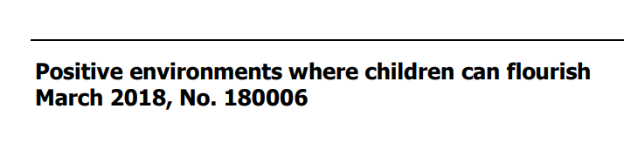
March 2018
Updated 6 October 2021
Notes:
So, while this is English guidance from Ofsted, this document offers a more helpful statement to make it clear.

Slide 12
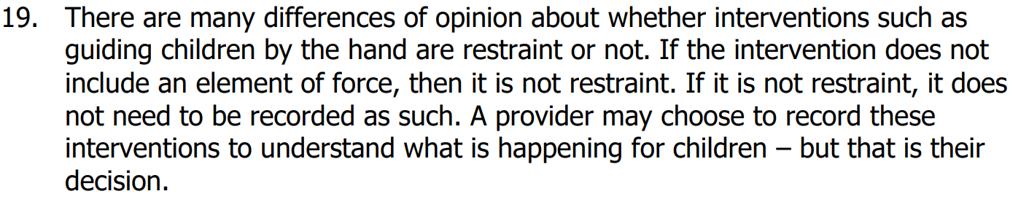

Slide 13
Was the intervention Restrictive or Non-Restrictive?
Was there any force involved?

Slide 14
Non Restrictive and Restrictive
There are 2 types of physical intervention:
Non-Restrictive interventions
Restrictive interventions

Slide 15
Non Restrictive Interventions
Non-Restrictive physical interventions include:
Touch
Guiding
Notes:
Any form of touch that DOES NOT include FORCE

Slide 16
Restrictive or Non-Restrictive?
Breakaways
Splitting up a fight
Notes:
Ask the group – you may need to explain what breakaways are for staff new to this line of work.
Answer for both – it will still come down to whether or not force was used (Use another trainer to demonstrate)
Breakaways – for example, if a child goes to punch you and you use a block whereby they strike your arm – you have not used any force and this would be non-restrictive.
However, if a child goes to punch you and you block and force their arm away from you then force is being used and this becomes restrictive.
Splitting up a fight – for example, if two children are fighting and not responding to verbal support – you may place an arm in between them and use touch on one of the children’s arm and they split away from the fight, then no force was used and it would be non-restrictive
However if you need to use force to pull a child away from the other to prevent greater harm, it would be restrictive.
So, to be clear, if force is used then an intervention will become restrictive.

Slide 17
Restrictive physical interventions involve the use of force
Restrictive Physical Intervention
Notes:
Key point: the use of FORCE to control a person’s behaviour.

Slide 18
Civil Law (Potential Liabilities)
A number of
Criminal Offences and Civil Wrongs
may be committed if a person uses
Physical Intervention
where that intervention is not
Justifiable and Reasonable.
Notes:
This is important in relation to potential litigation

Slide 19
Civil Law (Potential Liabilities)
You should be aware that if you
failed to act
and a young person is injured as a result, then you could face a civil claim for ‘damages’ due to
NEGLIGENCE in
failing to prevent
the injuries
Notes:
So If they FAILED to act... they could well be negligent – Link to DUTY OF CARE

Slide 20
Assault
“Assault
is committed when a person
intentionally
or recklessly causes another to apprehend
(fear for)
the immediate infliction of unlawful force”
[section 39 Criminal Justice Act 1988]
Notes:
FIRSTLY – ask the group to give you their definition of assault BEFORE you reveal the slide – establishes what they already know and highlights any misconceptions.
INTENTIONALLY – i.e. the person did it on purpose

Slide 21
Assault
Touch,
Actual Harm or
intention
is not important
[section 39 Criminal Justice Act 1988]
Notes:
This slide makes the point that ASSAULT does not need to include actually touching the person and it does not need to result in actual harm (injury).

Slide 22
Battery
“Battery
is committed when a person
intentionally or
directly applies
unlawful physical contact
against another”
Notes:
FIRSTLY – ask the group to give you their definition of battery BEFORE you reveal the slide – establishes what they already know and highlights any misconceptions.
Battery tends to be totally misunderstood as the word has been used in the wrong way, i.e. Fred went down the town on Saturday night and got BATTERED. The word tends to conjure up images of someone being seriously injured.

Slide 23
Battery
There
doesn’t need to be
injury
nor is
force
a requirement
Notes:
Make the point that the true definition of the term is very different.
Use example of the old man having stickers put onto his back by a youth in a shopping centre. The youth was spotted by an off duty policeman and charged with battery

Slide 24
Potential Liabilities
Application of
physical touch
UNINTENTIONAL or otherwise becomes an issue of
negligence

Slide 25
There are occasions when
Restrictive Physical Intervention (RPI) is an appropriate response to the risks presented in a particular situation
Restrictive Physical Intervention

Slide 26
However, the scale and nature of any physical intervention must be proportionate to both the behaviour of the individual to be controlled,
Restrictive Physical Intervention
AND the nature of
the harm they might cause
Notes:
Understanding the meaning of PROPORTIONATE and Reasonable Force is also VERY important

Slide 27
In order for an intervention to be
LAWFUL you must be able to demonstrate a
Lawful Excuse!
Lawful Intervention

Slide 28
Lawful Decision Making
For staff to be able to make safe and lawful decisions in the moment when faced with a dysregulated child
you must make a
DYNAMIC RISK ASSESSMENT
based on information available to you at the time

Slide 29
Two steps of RISK ASSESSMENT
Identify the HAZARD and who may be harmed
2. Evaluate the RISK and decide on
control measure required

Slide 30
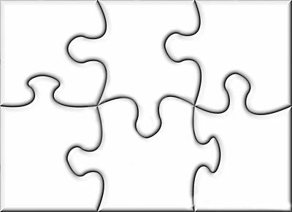
Lawful Excuse Components
?
?
?
?
?
?
Notes:
Staff need to understand that each part of the Jigsaw puzzle is roughly the same size, i.e. each lawful excuse component carries approximately the same weight. One is not more important than any of the others, they all make up ‘THE PICTURE’ of having a LAWFUL EXCUSE

Slide 31
Lawful Excuse Components
Last Resort
?
?
?
?
?
Notes:
Staff need to understand that each part of the Jigsaw puzzle is roughly the same size, i.e. each lawful excuse component carries approximately the same weight. One is not more important than any of the others, they all make up ‘THE PICTURE’ of having a LAWFUL EXCUSE

Slide 32
Last Resort
2 Versions!
Tried OTHER things first
The RISK was IMMEDIATE (Last resort was your first resort!)

Slide 33
Last Resort
The opportunity to STOP?
DID YOU
GIVE THEM CHANCE TO
STOP PRIOR to physically
holding the person?
Notes:
Why would we ask them to STOP? Because they might!
Your voice is a lower level of intervention than physical touch.

Slide 34
The Opportunity to Stop?
DID you use the word STOP?
DID THEY
understand
WHAT
you were saying?

Slide 35
Lawful Excuse
?
Last Resort
Best Interests
?
?
?

Slide 36
Best Interest - ethical
You are ACTING in the person’s
BEST INTERESTS
Notes:
Example of man attempting to jump out of a 3rd storey window of a hospital
2 carers pulling the man off a window sill and injured his leg
When it went to court the judge asked the man what his intention was of why he climbed onto the window sill, he said he wanted to kill himself and the case was dismissed.

Slide 37
Lawful Excuse
Last Resort
Reasonable Force
Best Interests
?
?
?

Slide 38
Reasonable Force
There is no legal definition of
Reasonable Force
To be judged lawful, the force used would need to be in PROPORTION to the consequences it is
intended to prevent
Notes:
The description above is how a court would decide on whether an intervention was lawful or not

Slide 39
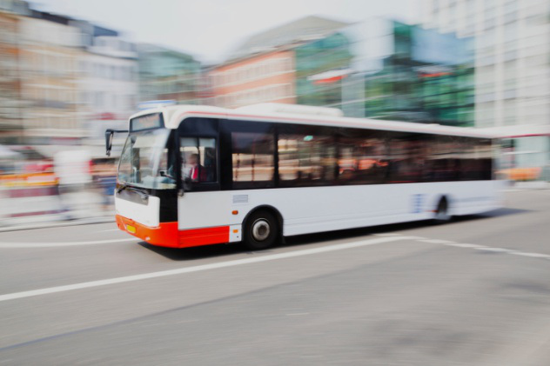
Reasonable Force?
Notes:
Give example of someone running in front of a bus!
So if you grabbed someone as they were ABOUT to step in front of SPEEDING Bus, and you injured them by doing so – Let’s say you popped their shoulder out by the force you pulled them back, would the force you used be likely to be deemed as REASONABLE?
ABSOLUTELY! You STOPPED them from being hit by a bus! And likely being killed!

Slide 40
Reasonable Force
Consider
MINIMUM (Least amount of) force and
NOT
just reasonable!
Notes:
Convey ‘best practice’ as being MINIMUM force, rather than just reasonable force.

Slide 41
Lawful Excuse
Last Resort
Reasonable Force
Best Interests
Greater Harm
?
?

Slide 42
Greater Harm
Your
ACTIONS will
PREVENT a
Greater Harm
from occurring!
Notes:
Let’s think back to our BUS example!

Slide 43
Lawful Excuse
Last Resort
Reasonable Force
Best Interests
Greater Harm
?
Proportionate

Slide 44
Proportionality
Your ACTIONS
are proportionate to the CONSEQUENCES
you are trying to
PREVENT!

Slide 45
Lawful Excuse
Last Resort
Reasonable Force
Best Interests
Greater Harm
Honest Held Belief
Proportionate

Slide 46
Honest Held Belief
Describes your honest held belief based on:
Your knowledge of the person
information available to you at the time
that you believed that if you DIDN’T act then a GREATER HARM would occur!
Notes:
Describes your honest beliefs based on the information available to you at the time and your knowledge of the person
That you believed that if you DIDN’T act then a GREATER HARM would occur

Slide 47
Last Resort
Best
Interests
Reasonable
Force
Honest
Held
Belief
Greater
Harm
Proportionate
Notes:
Re-emphasise points from earlier

Slide 48
Lawful Excuse Criteria
Serious Harm To Self
Serious Harm To Others

Slide 49
Lawful Excuse Criteria
What is meant by
Serious Harm?
Notes:
The following slide is the DoH (Department of Health) definition.

Slide 50
Lawful Excuse Criteria
Actual or Grievous Bodily Harm

Slide 51
Serious Harm
ABH
Marks to skin
Scratches
Bruises
Minor Cuts
GBH
Broken Bones
Broken Teeth
Serious Cuts
Notes:
Actual is marks, bruises, scratches, minor cuts
Grievous is broken bones, broken teeth and cuts that bleed!
Case law: at least 1 drop of blood falls outside the body!

Slide 52
How To Write Serious Harm
Due to …….. [be specific] ..…….
I was concerned that …….. [describe harm] ………… ……. ……………….

Slide 53
Serious Harm
Marks to skin
Scratches
Bruises
Minor Cuts
Broken Bones
Broken Teeth
Serious Cuts
Notes:
Actual is marks, bruises, scratches, minor cuts
Grievous is broken bones, broken teeth and cuts that bleed!
Case law: at least 1 drop of blood falls outside the body!

Slide 54
Lawful Excuse Criteria
Actual or Grievous Bodily Harm
Physical or
Sexual Abuse
Risking the Lives of, or Injury to, Self or Others by Wilful or Reckless Behaviour
Self
Poisoning
Notes:
Actual Harm is marks, bruises, scratches, minor cuts
Grievous Harm is broken bones, broken teeth and cuts that bleed! - Case law: ‘at least 1 drop of blood falls outside the body!

Slide 55
Lawful Excuse Criteria
Serious Damage to Property

Slide 56
Lawful Excuse - schools
(a) committing any offence,
(b) causing personal injury to, or damage to the property of, any person (including the pupil himself), or
Notes:
A person to whom this section applies may use such force as is reasonable in the circumstances for the purpose of preventing a pupil from doing (or continuing to do) any of the following.

Slide 57
Lawful Excuse
(c) prejudicing the maintenance of good order and discipline at the school’ (Education and Inspections Act 2006).

Slide 58
Legal Defences Re-cap
As a general rule, nobody has the right to
touch, move,
hold or contain
another person
Notes:
This slide and the next two slides are used for a quick recap before asking if there are any questions

Slide 59
Legal Defences Re-Cap
Whenever they do so they should be clear about
why
it is
NECESSARY

Slide 60
Legal Defences Re-Cap
The best legal defence
would be to show that any actions taken were in the person’s
BEST INTEREST
and that they were
REASONABLE and PROPORTIONATE

Slide 61
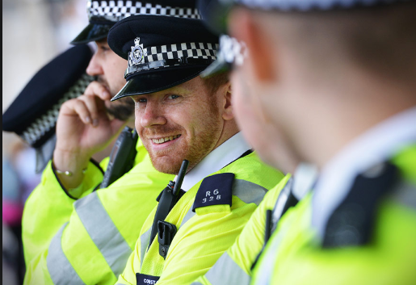
Police Involvement
Discuss the organisations ‘Police involvement’ policy and signpost where people can find it.
Notes:
On the policy there is a form that ask questions to make a decision around when police should be involved.
If there is an emergency situation involving an RPI then the police can be called. This might be on an individual risk assessment. E.g. A young person is wearing a cast and cannot be held or another health related issue.
Typical behaviours where police are involved are:
Absent/missing episodes
Violence on another YP
Violence on staff
Criminal damage on the home
Theft within the home
Criminal damage to staff cars or property
Substance misuse
Hate Crime
CSE or radicalsation
This decision should be made by a manager and pre-empted into plans.
Focus on not criminalising the young people.

Slide 62


Slide 63
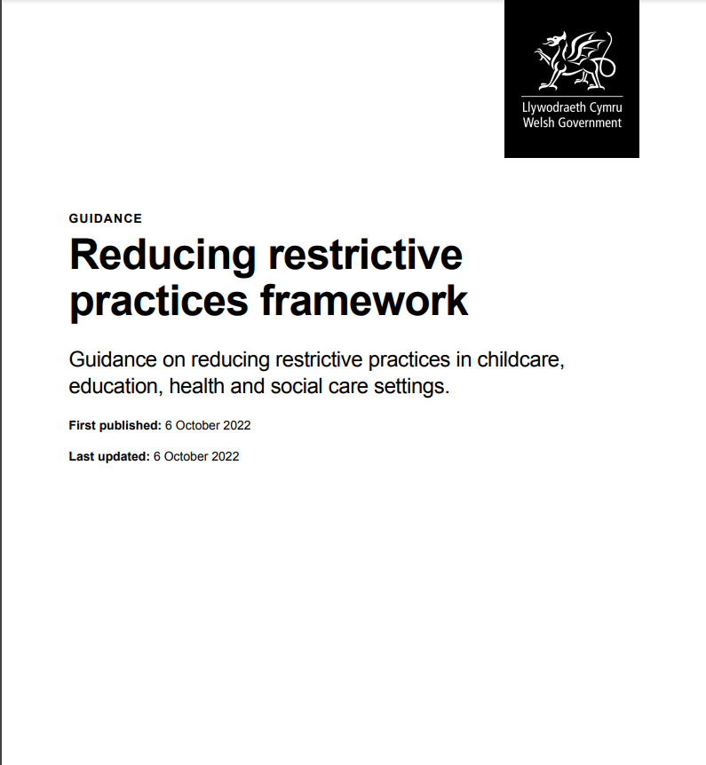

Slide 64

Any Questions?

